Slide 1
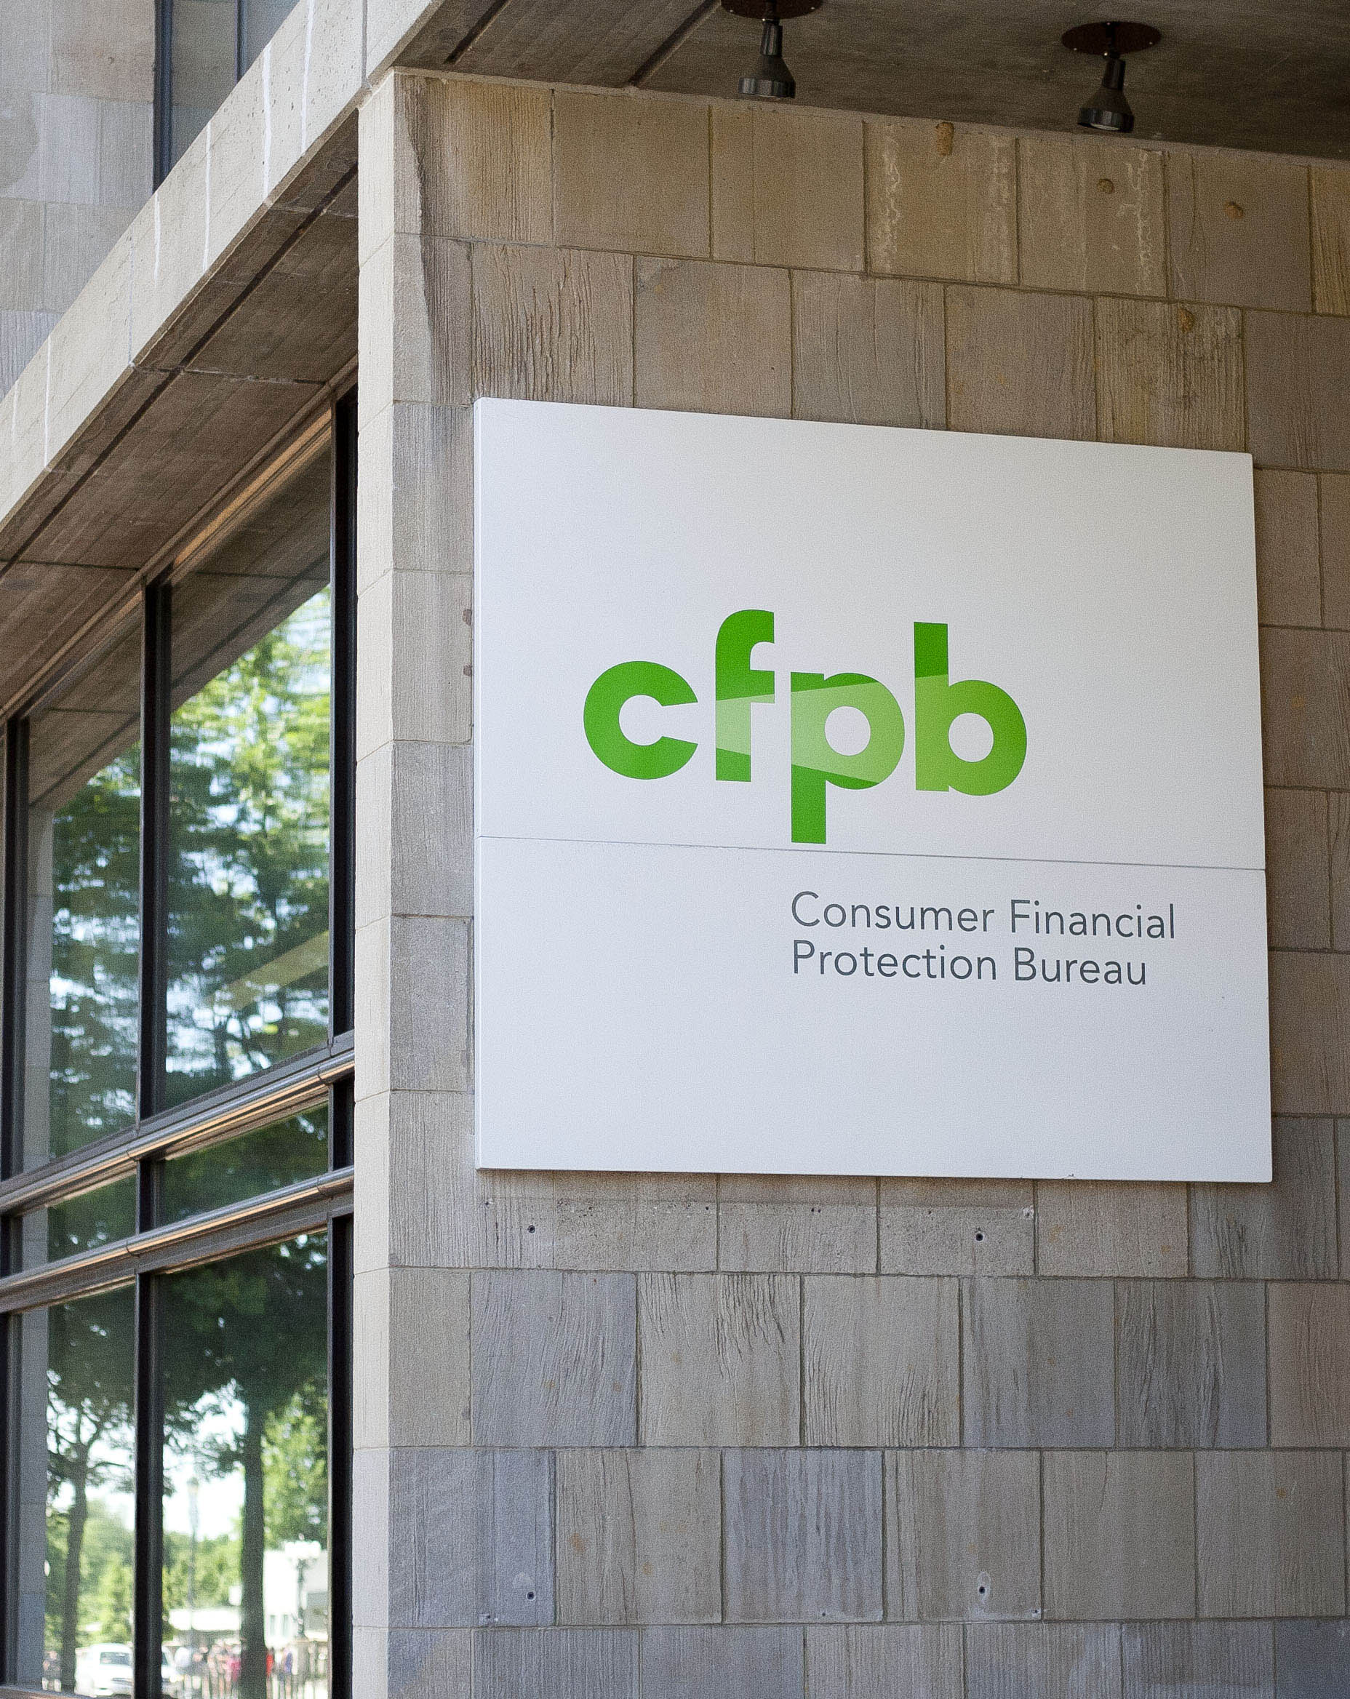

Consumer’s Complaint Analysis
Presented by:
Krishna Charan B C
Rushan Shakya
Rupam Das
Vivek Samantray
Notes:
To change the image on this slide, select the picture and delete it. Then click the Pictures icon in the placeholder to insert your own image.

Slide 2
Today’s Agenda
Introduction
Road Map of Project
Conclusion
Question and Answers
References

Slide 3
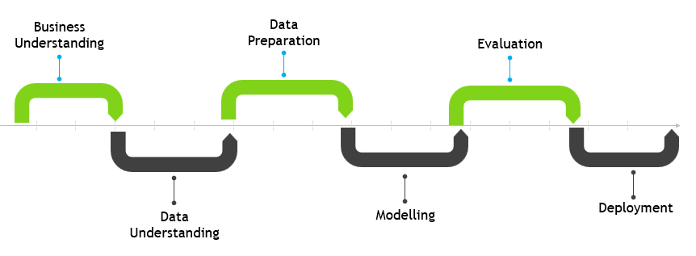
Road Map of Project

Slide 4
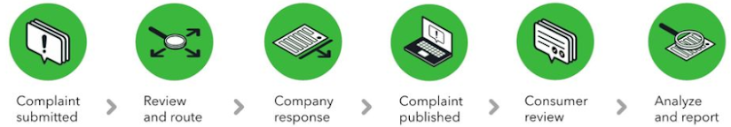
Business Understanding
Consumer Financial Protection Bureau (CFPB)
Single point of regulatory board to enforce federal consumer financial laws
Focuses on imposing laws that outlaw discrimination in consumer finance
Researching the consumer experience with financial products
Source: https://www.consumerfinance.gov/

Slide 5
Key Stakeholders and Challenges
CFPB
Maintaining the integrity in financial consumer market
Financial Institutions
Resource management to resolve consumer complaints
Consumers
Skeptical to select financial products and services

Slide 6
Business Objectives
Predict the financial institutions’ responses to consumer complaints
Classify the seriousness of a complaint using demographic data
Predict mortgage issues using Personal Income Tax data
1
Objectives
2
3

Slide 7
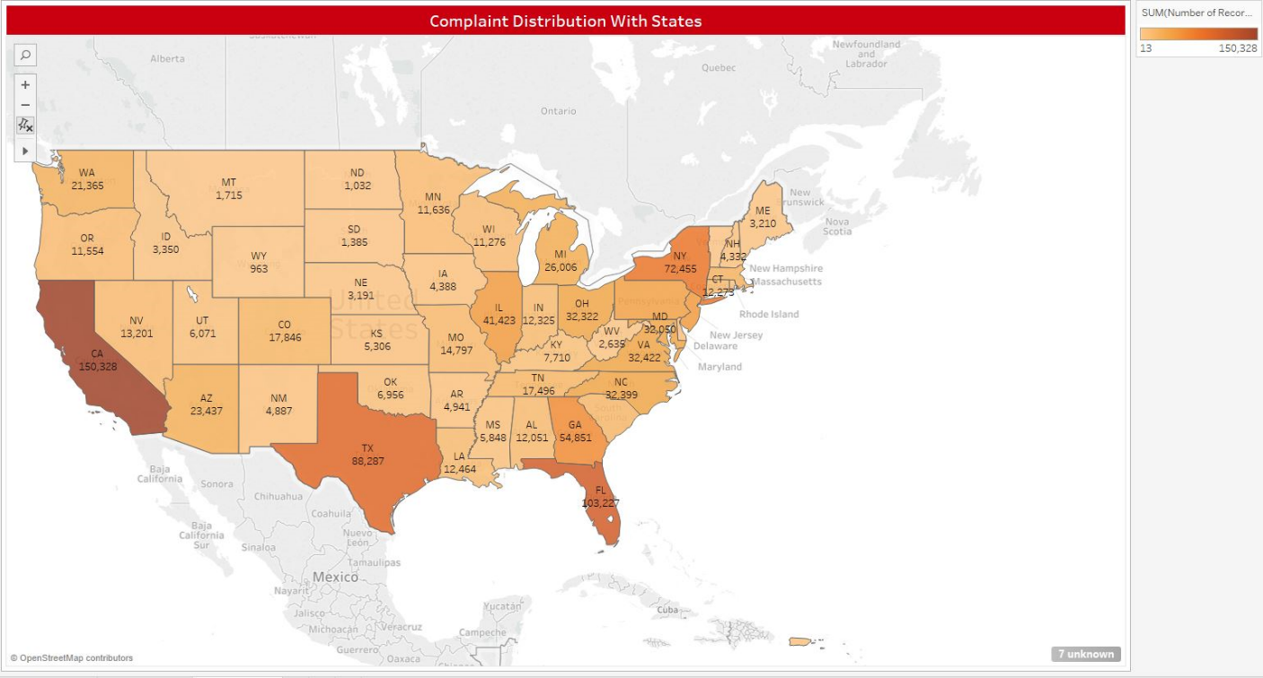
Data Understanding
CFPB Dataset
Complaints received about financial services and products
Includes attributes like data, product, issue, company, response
Source: CFPB Consumer Complaint Database

Slide 8
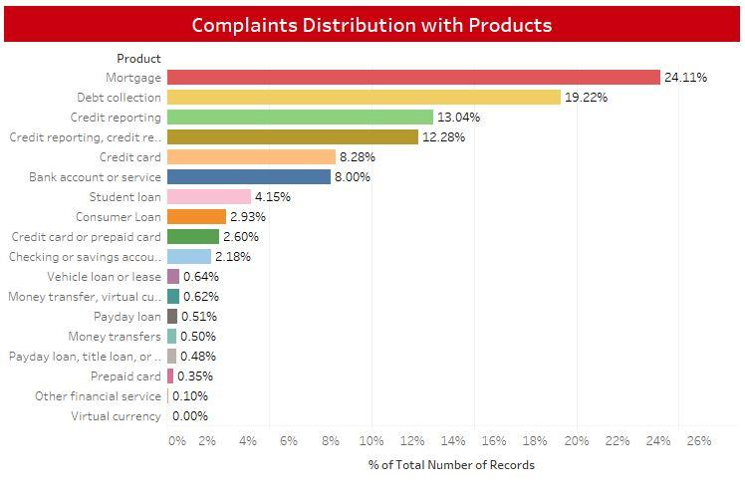
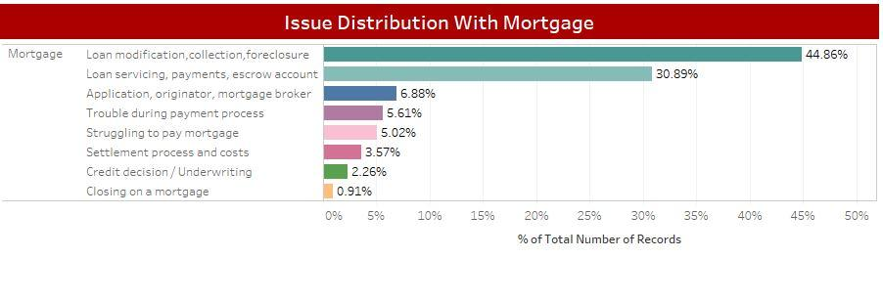
Data Understanding
24% complaints are related to Mortgage
44.86% Loan modification, Collection, foreclosure
30.89% Loan servicing, payments, escrow account

Slide 9
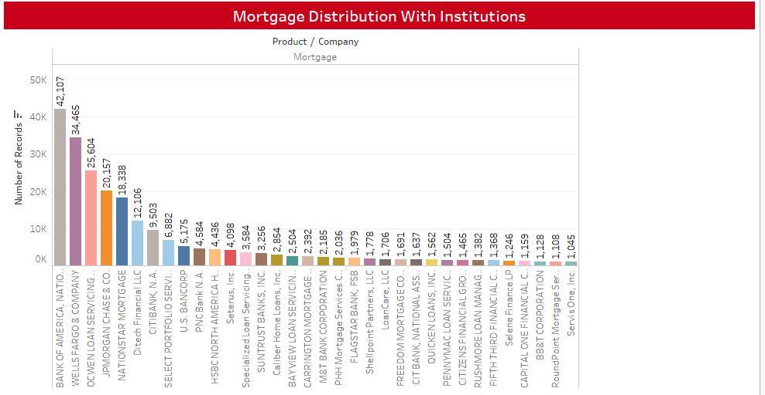
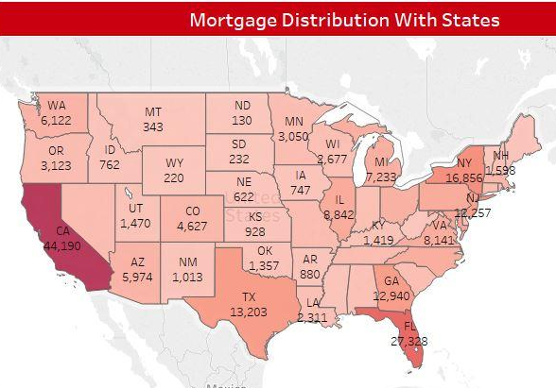
Data Understanding
Bank of America has highest number of
Mortgage related complaints
California has highest number of
Mortgage related complaints

Slide 10
Additional Data sources
Two additional datasets integrated with CFPB dataset
- DEMOGRAPHICS DATA
Includes attributes like cost of living, houses with and without mortgage, house value, household income for each ZIP code in Texas state.
Web-scraped from www.city-data.com
- SOI TAX STATS - Individual Income Tax Statistics dataset
Includes income and tax items classified by State, Zip Code, and the size of adjusted gross income
Data source: Internal Revenue services (IRS)

Slide 11
Data Preparation
Data Cleaning
Merging multiple data sources
Data Normalization
Data partitioning
K-fold cross validation

Slide 12

Objective 1
Predict Company Response to a Consumer Complaint
Part I - CFPB dataset
Part II - CFPB dataset integrated with IRS dataset

Slide 13
Modeling
Dataset | Model | Precision | Recall | F1-Score
CFPB | Decision Tree | 69 | 71 | 70
CFPB + IRS | Decision Tree | 78 | 78 | 78
 | Random Forest | 79 | 86 | 81
Integrated dataset – Random Forest
Positive Class: Company fault

Slide 14
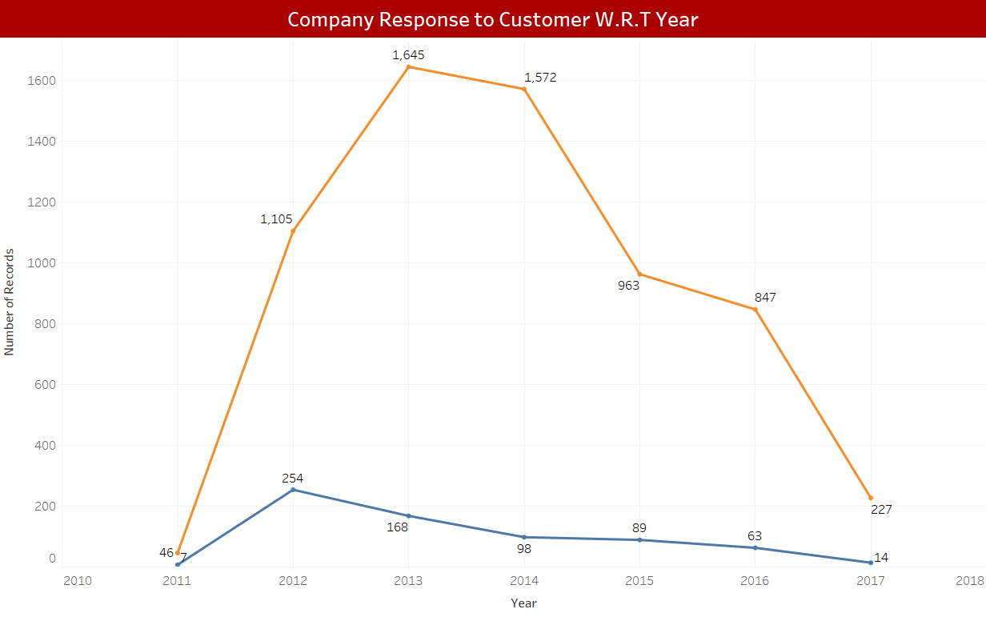
Modeling
Feature Importance
Company
Year
ZIP code
Gross Income

Slide 15
Evaluation
Sensitivity (Recall) : 86%
Focus on complaints lead to financial payoffs

Slide 16
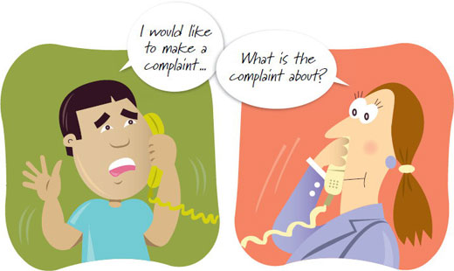
Objective 2
Classify the seriousness of a complaint
CFPB dataset integrated with demographic data

Slide 17
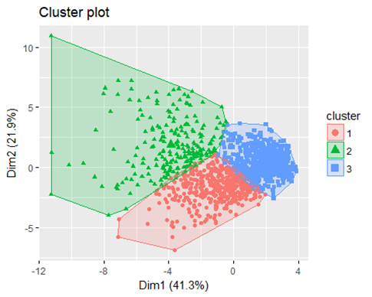
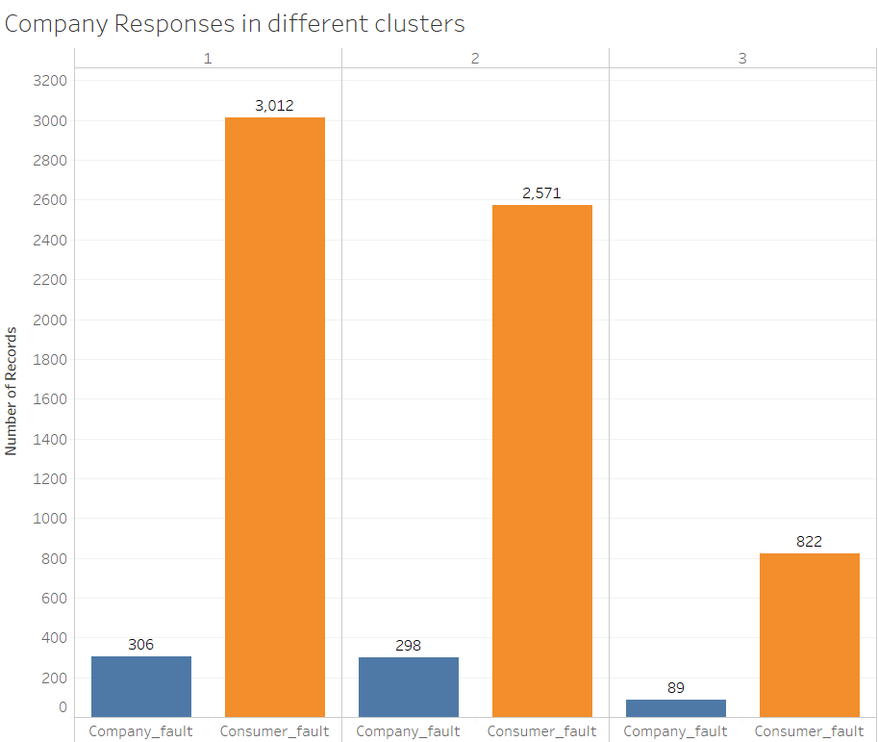
Data Preparation
Data Transformation
Two response categories
Consumer fault and Company fault
Cluster Analysis
3 clusters identified using demographics
Cluster 1: Unsettled Community
Cluster 2: Working Class Community
Cluster 3: Settled/Retired Community
Multicollinearity
Multicollinear variables excluded
Number of houses, property tax and few others

Slide 18
Modeling
Model | Balancing | Accuracy | Sensitivity | Specificity | AUC
Decision Tree | Unbalanced | 90.2 | 1.44 | 99.84 | 50.6
 | Over Sampling | 66 | 64 | 66 | 65
 | Under Sampling | 46 | 77.53 | 42.7 | 60
 | ROSE | 61 | 67 | 60 | 64
SVM | Unbalanced | 90 | 0 | 100 | 50
 | Over Sampling | 77 | 35 | 82 | 59
Nnet | Over Sampling | 62 | 47 | 64 | 55.6
90.2% !!! - Accuracy Paradox
Decision Tree – Over Sampling
Positive Class: Company fault

Slide 19
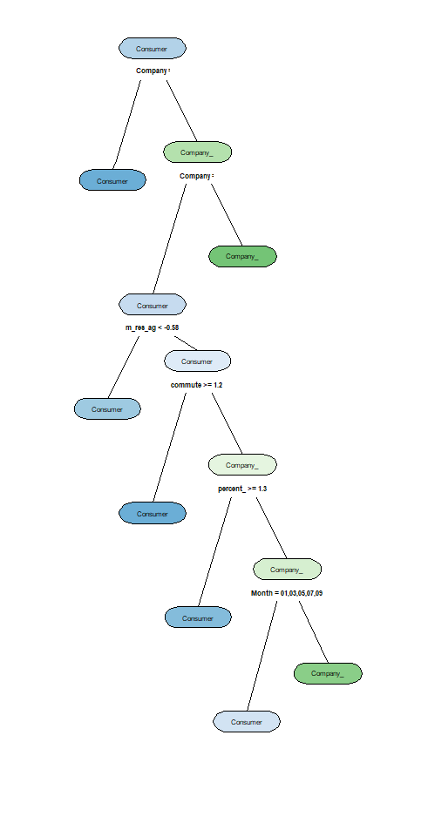
Modeling
Feature Importance
Company
Resident Age
Percent of Renters
Month
Issue
Commute Time

Slide 20
Evaluation
Seriousness of complaint identified with 66 percent accuracy
Identification of complaint reduces scrutiny of a complaint
Improved resource optimization and response time (customer service)
Cost of inaccuracy

Slide 21

Objective 3
Predict mortgage issues
CFPB dataset integrated with Personal Income Tax data

Slide 22
Modeling
Decision Tree and Random Forest Classifiers used
2 analysis: Complaints dataset alone, Complaints with IRS data
Parameter Tuning
Grid Search CV function
K-Fold Cross Validation
Model | Accuracy | Recall | F1-Score
Decision Tree | 48.46 | 48 | 49
Random Forest | 59.83 | 60 | 55
Random Forest

Slide 23
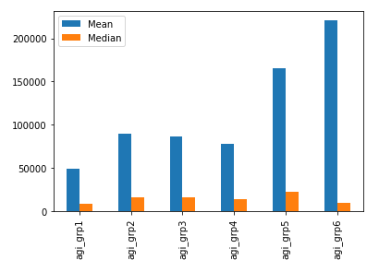
Modeling
Feature Importance
Month
ZIP code
Gross Income
Dependents

Slide 24
Evaluation
Sensitivity (Recall): 60%
Financial institutions mitigate issues related to product
Consumers better decision making for opting products
CFPB improve awareness of product details

Slide 25
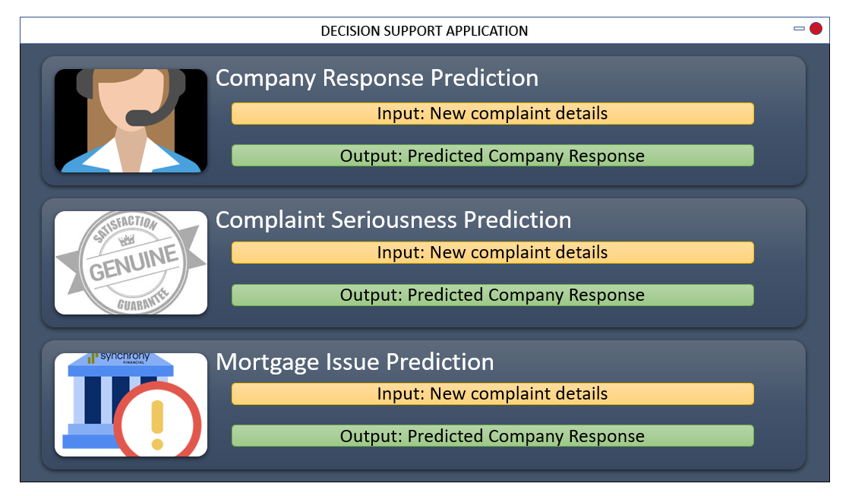
Deployment
Data Repository
Tableau Dashboards
Decision Support System
3 models built for 3 objectives
Graphical User Interface
Monitoring and Updating Models
Feedback loop
User acceptance challenge

Slide 26
Conclusion
Prediction of company responses and issues to be raised, will assist CFPB to maintain integrity
Improve complaint resolution rate
Identify the serious complaints for timely resolution
Optimize the usage of various resources of financial institutions
Assist the financial institutions to fine tune the business processes
Assist the consumers in decision making while opting for products or services
Deployment of models in real business operations, while considering the business constraints, will allow the stakeholders to function efficiently, however, continuous monitoring, improvement, and viability check of outcomes are necessary to make it a success.

Slide 27
References
CFPB Data Analysis
Fonseka, W. R., Nadeesha, D. G., Thakshila, P. M., Jeewandara, N. A., Wijesinghe, D. M., Sahabandu, R. V., & Asanka, P. P. (2016). Use of data warehousing to analyze customer complaint data of Consumer Financial Protection Bureau of United States of America. 2016 IEEE International Conference on Information and Automation for Sustainability (ICIAfS). doi:10.1109/iciafs.2016.7946520
Mortgage Issues
Kang, K. (2018). Mortgage Loan Prediction: Bayesian Machine Learning Approach. Financial Stability Studies, 19(1), 99-129. doi:10.26588/kdic.2018.19.1.004
Complaint Analysis
Garding, S., & Bruns, A. (2015). Analysis of Customers’ Complaint Channel Choice and Complaint Behaviour. SpringerBriefs in Business Complaint Management and Channel Choice, 35-74. doi:10.1007/978-3-319-18179-0_4
Heuristics and Biases
Nicholls, N. (1999). Cognitive Illusions, Heuristics, and Climate Prediction. Bulletin of the American Meteorological Society, 80(7), 1385-1397. doi:10.1175/1520-0477(1999)0802.0.co;2
Heuristics and Biases in the Intuitive Projection of Retail Sales Author(s): Anthony D. Cox and John O. Summers Source: Journal of Marketing Research, Vol. 24, No. 3 (Aug., 1987), pp. 290-297
Doswell, C. A. (2004). Weather Forecasting by Humans—Heuristics and Decision Making. Weather and Forecasting,19(6), 1115-1126. doi:10.1175/waf-821.1
Goodwin, P., & Wright, G. (1994). Heuristics, biases and improvement strategies in judgmental time series forecasting. Omega, 22(6), 553-568. doi:10.1016/0305-0483(94)90047-7

Slide 28

Thank you!!

